Slide 1



DEPARTMENT OF COMPUTER SCIENCE AND BUSINESS SYSTEMS
Smart Tourist Safety Monitoring & Incident Response System

Slide 2




ABSTRACT
Problem Statement:
Tourists face safety risks like accidents, theft, harassment, and medical emergencies in unfamiliar locations, and existing solutions are reactive, fragmented, or city-specific.
Objectives:
Develop a web and mobile application ensuring real-time tourist safety using AI for risk prediction, geo-fencing for location alerts, and blockchain for secure digital IDs, while enabling instant SOS and centralized authority monitoring for proactive, coordinated emergency response.
Theme: Smart Tourism Safety & Digital Security using AI, Blockchain, and Geo-Fencing.
Type: Software
Team Name: Mabuz
The Smart Tourist Safety & Guardian Platform ensures real-time protection for tourists by integrating AI for risk prediction, geo-fencing for location alerts, and blockchain for secure digital identities. It proactively prevents accidents, thefts, and emergencies in unfamiliar locations.
The system provides instant SOS communication and centralized authority monitoring, enabling coordinated emergency response. By combining mobile/web applications with predictive technologies, it enhances safety, trust, and overall tourism experience.

Slide 3


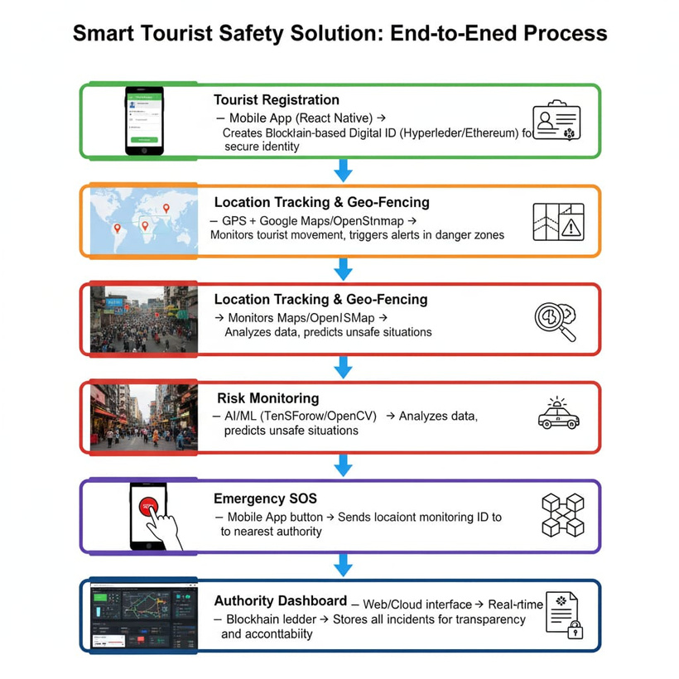


SMART TOURIST SAFETY MONITORING &
INCIDENT RESPONSE SYSTEM
PROPOSED
SOLUTION
Proactive Protection: System predicts and prevents risks using AI and real-time location tracking.
Integrated Coordination: Tourists, authorities, and services connected through a secure digital ID and centralized dashboard.
2

Slide 4
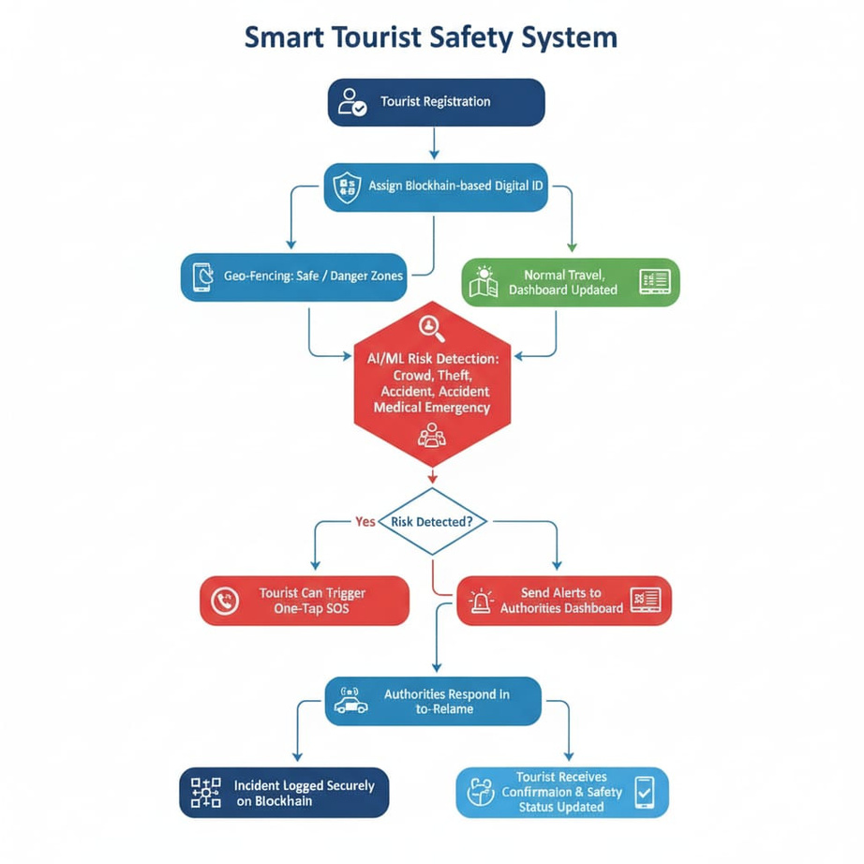

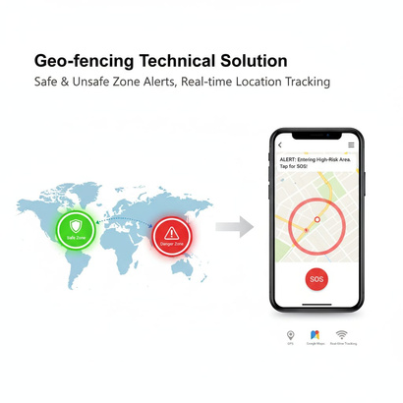
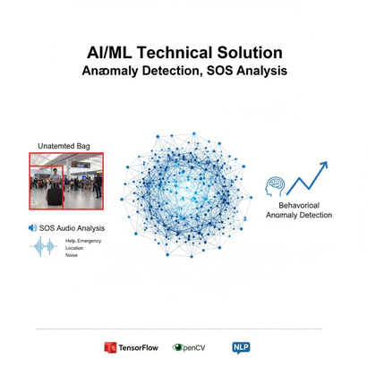
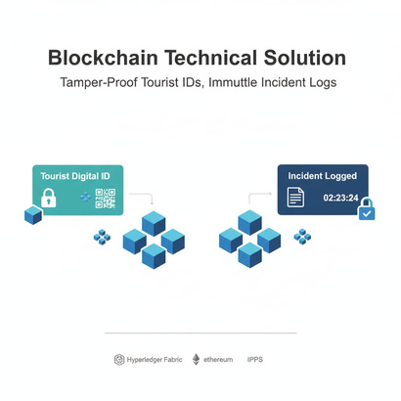

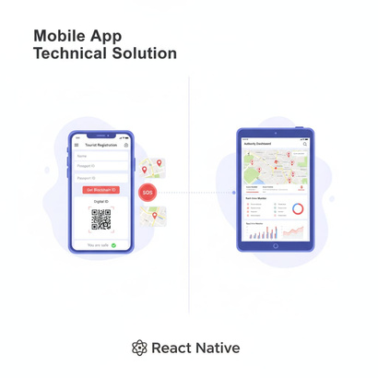

TECHNICAL APPROACH
WORKFLOW
TECHNOLOGIES
3

Slide 5
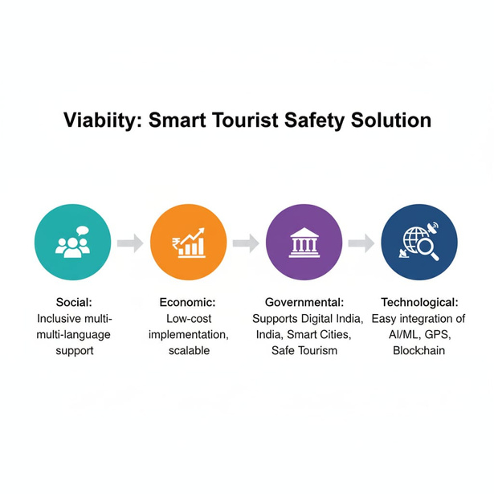
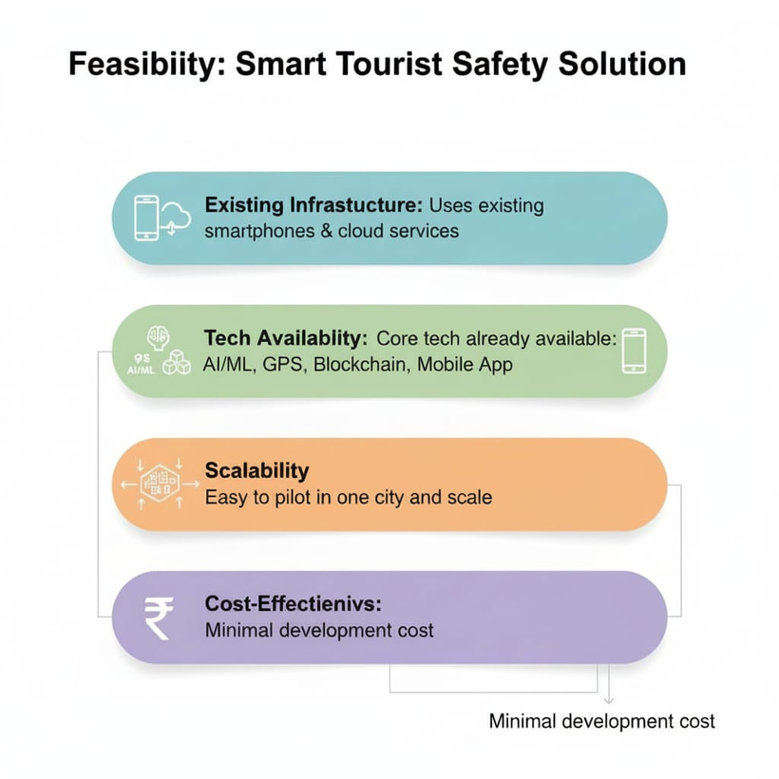
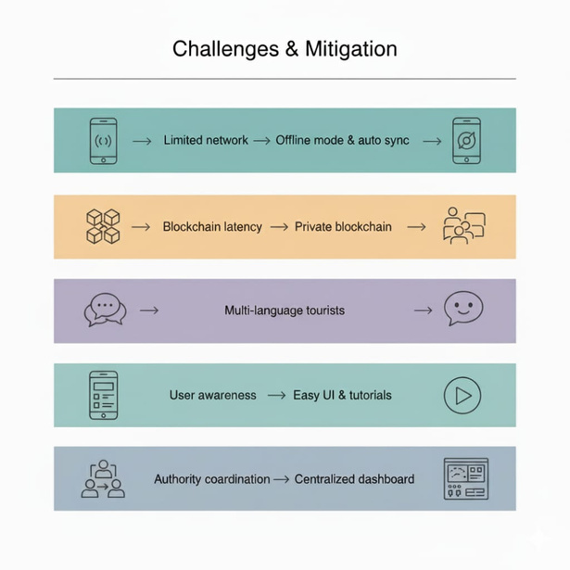

FEASIBILITY AND VIABILITY
FEASIBILITY
VIABILITY
CHALLENGES AND MITIGATION
4

Slide 6
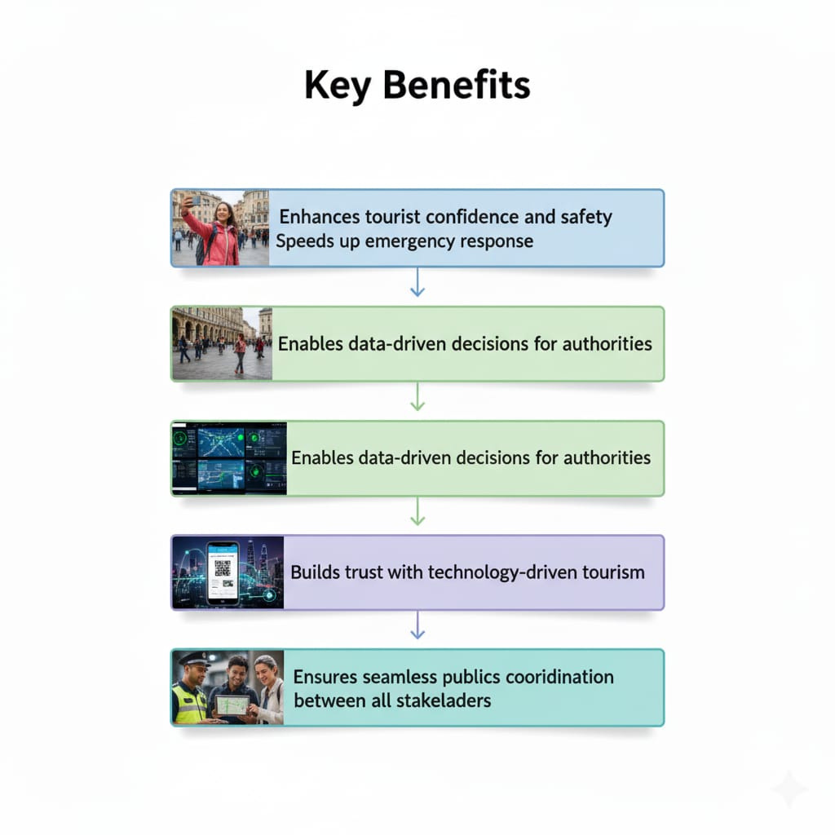
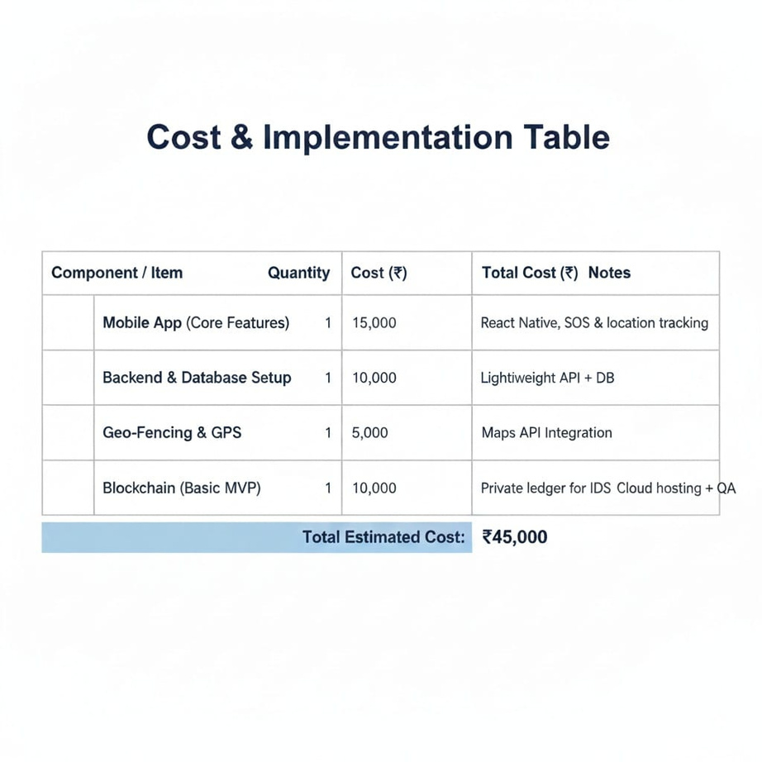
IMPACT AND BENEFITS
Tourist Safety: Reduces risks and ensures faster emergency response.
Authority Efficiency: Enables real-time monitoring and data-driven decision making.
Smart Tourism Growth: Builds trust, promotes technology-driven safe tourism.
COST ESTIMATION
1
2
3
4
5

Slide 7


RESEARCH AND REFERENCES
Artificial Intelligence in the Tourism Business: A Systematic Review – Frontiers in AI
A Blockchain-Based Framework for Smart Tourism – Scirp.org.SMART GEO FENCING for Safety Monitoring – IJRPR
Tourism Safety Monitoring Information System using IoT & Blockchain – ResearchGate
REFERENCES
SMART GEO FENCING for Safety Monitoring – IJRPR
Blockchain Technology for Smart Tourism Destinations – MDPI Sustainability
AI and Sustainable Tourism: An Assessment of Risks and Opportunities – Taylor & Francis Online
RESEARCH
6

Slide 8

THANK YOU
ANY QUERIES?

